Slide 1
MET CS 677 Term Project: House Sales Price Determining Factor in King County, USA
Hao Wu
11/29/2021

Slide 2
Research Scenario
The price of a house is often an important part of human society and economy, and the price of a house is usually affected by the size of the house, the number of rooms, and the area where the house is located. This data set includes the housing sales data of the king country from 2014 to 2015, as well as the specific parameters of the houses.
Link: https://www.kaggle.com/harlfoxem/housesalesprediction

Slide 3
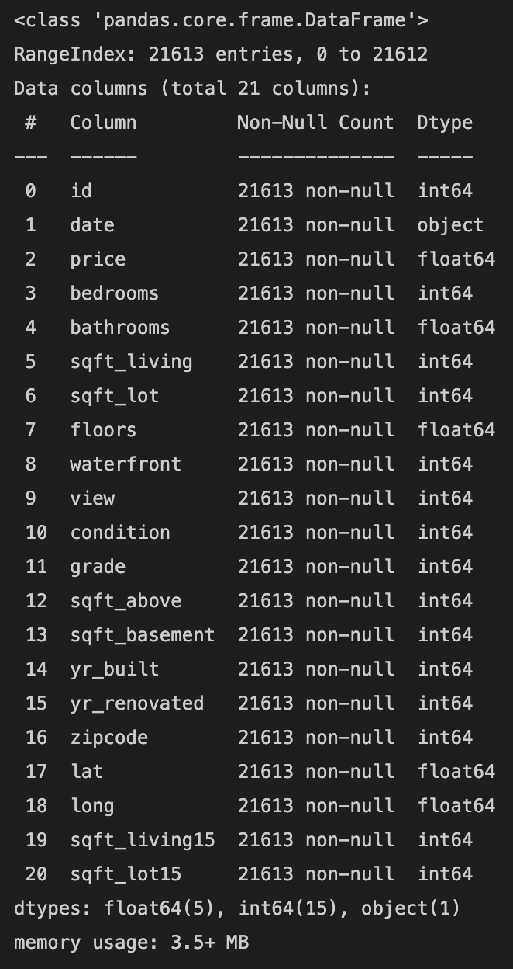
Data Set
Link: https://www.kaggle.com/harlfoxem/housesalesprediction
Description Link:
https://www.kaggle.com/harlfoxem/housesalesprediction/discussion/207885

Slide 4
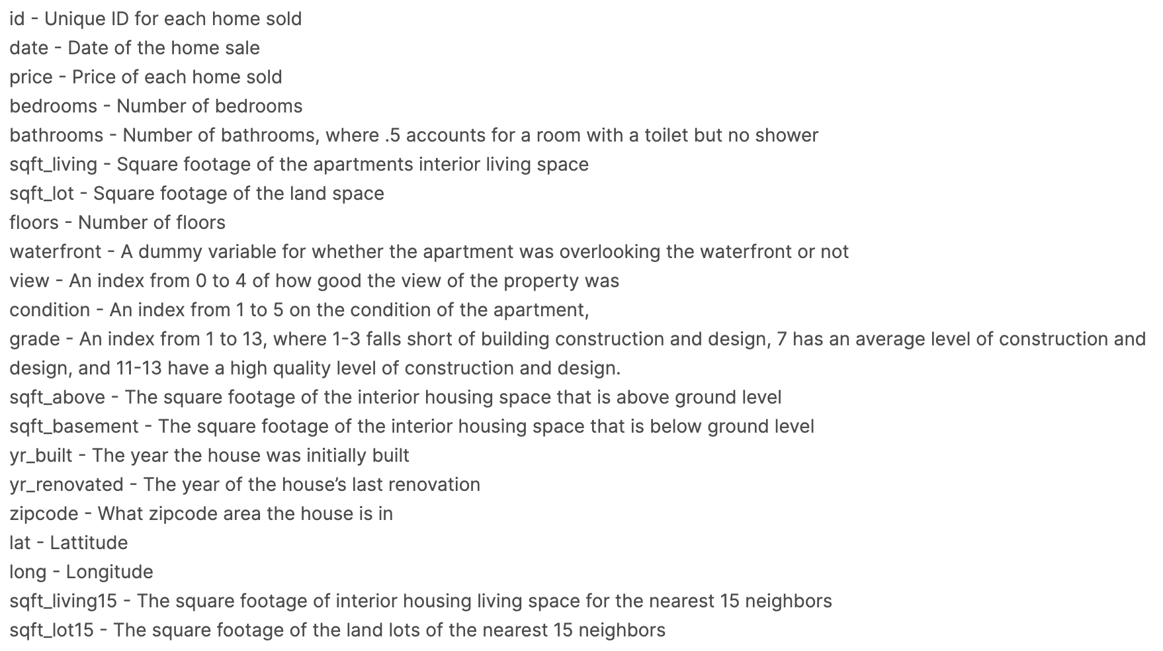

Slide 5
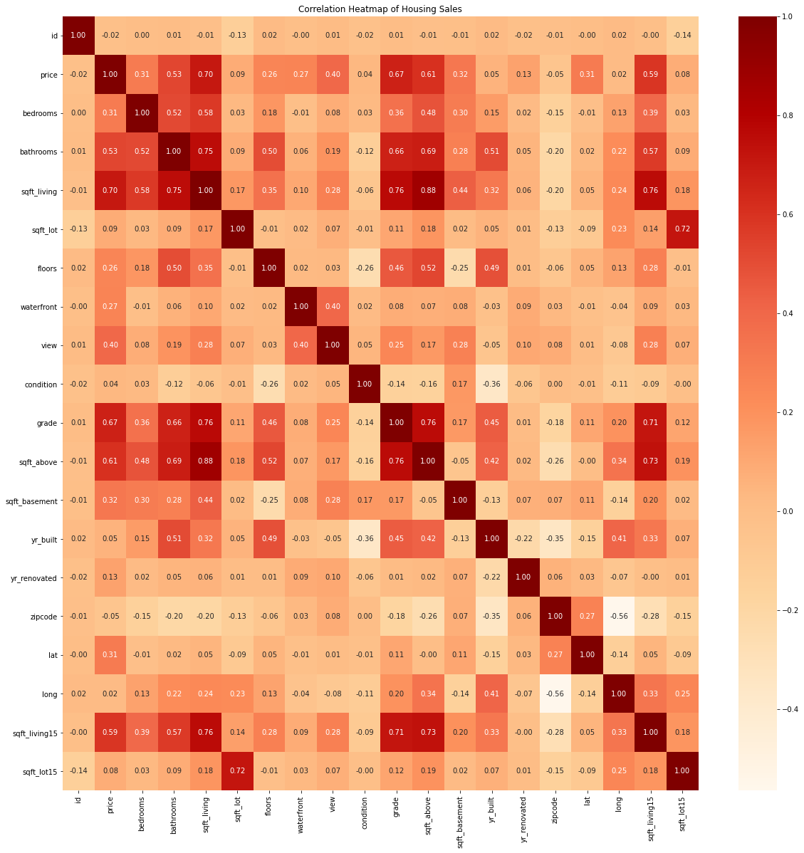
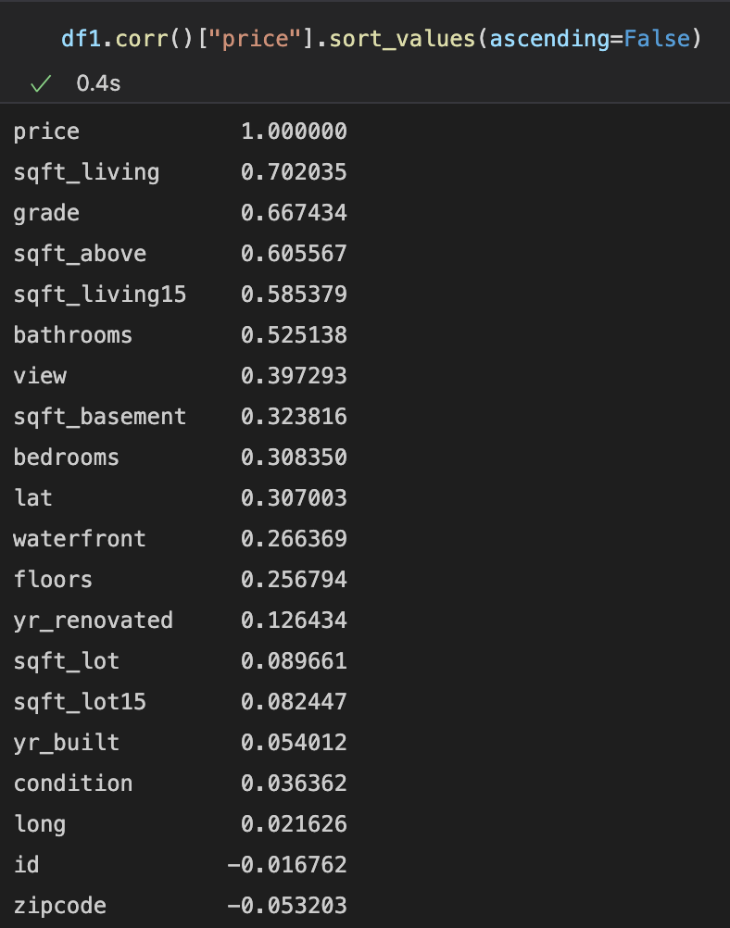
Description

Slide 6
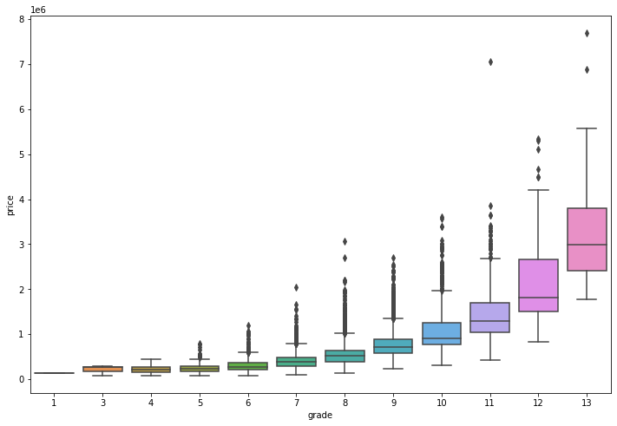
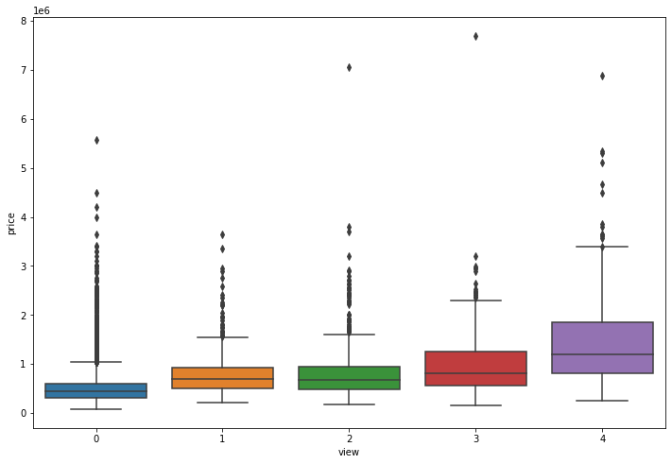
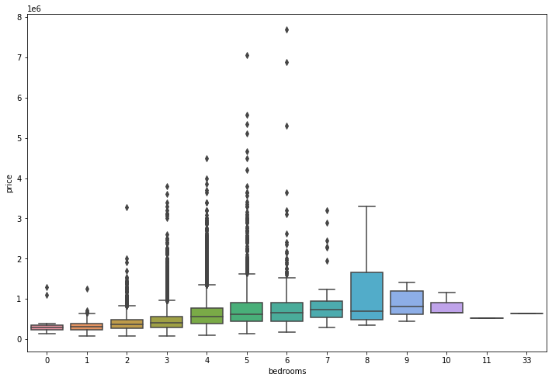
Description

Slide 7
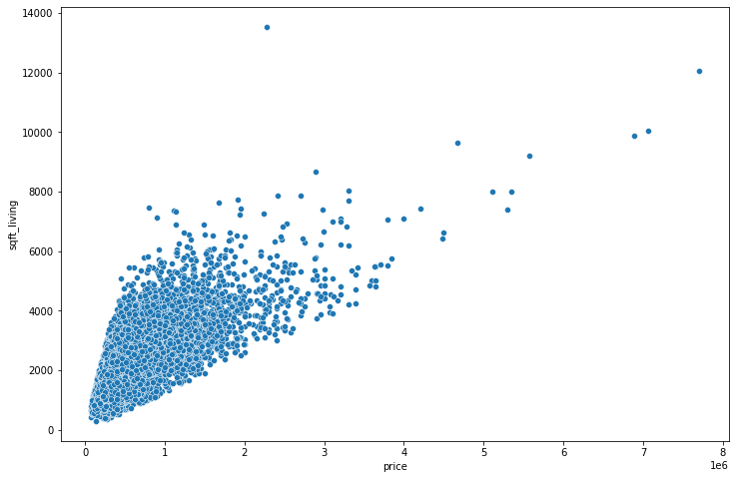
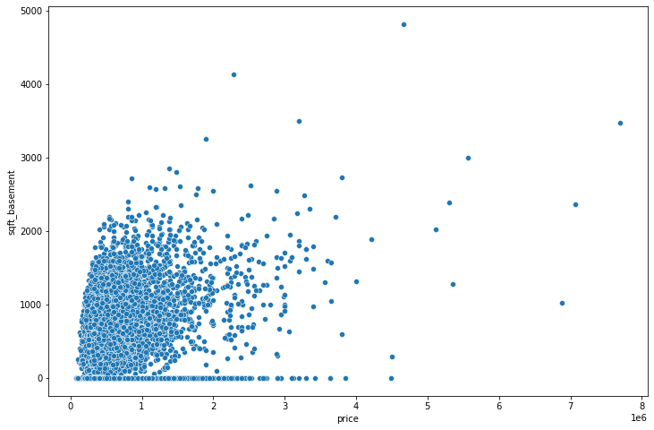
Description

Slide 8
Model Evaluation and Algorithms Select
Linear Regression
Decision Tree
Random Forest

Slide 9
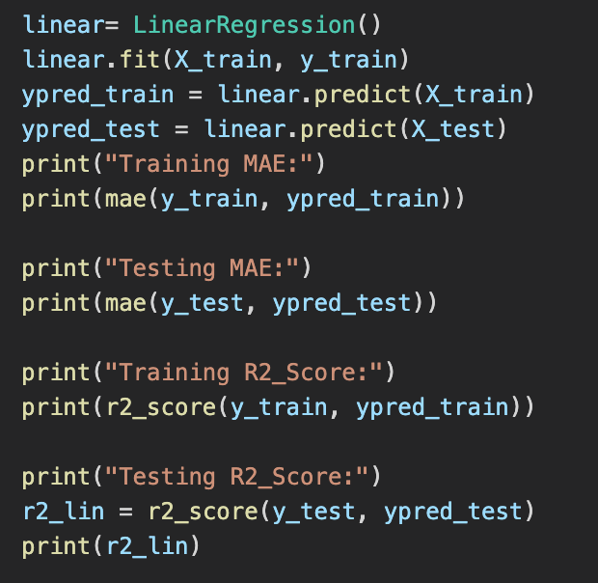
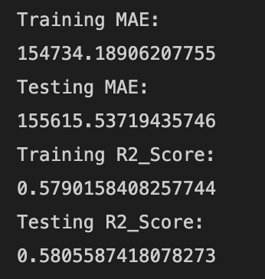
Linear Regression

Slide 10
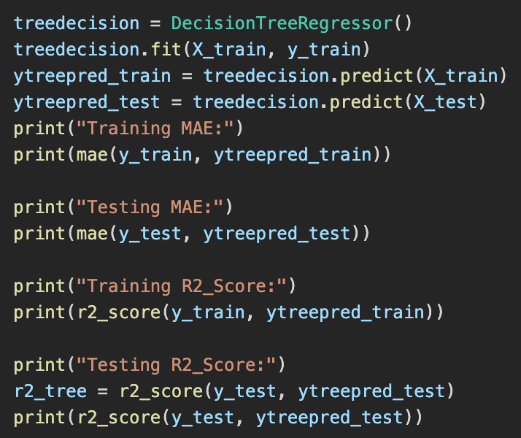
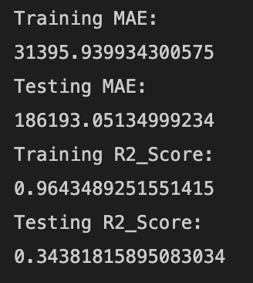
Decision Tree

Slide 11
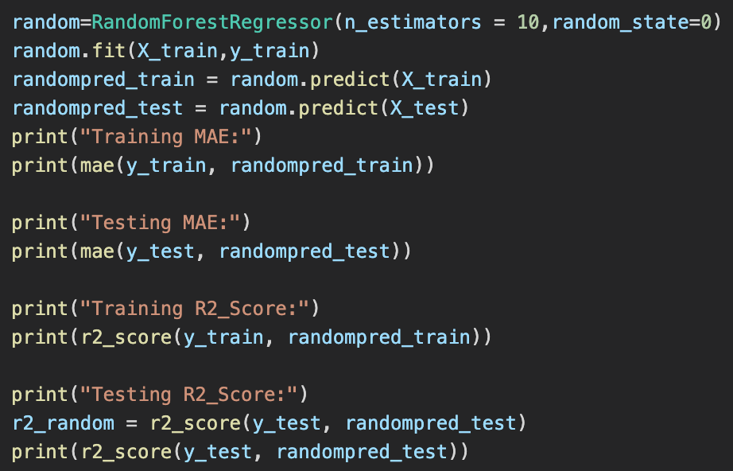
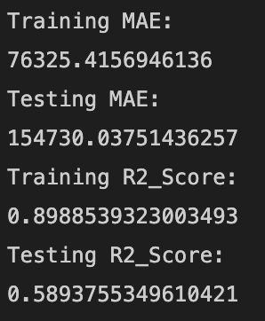
Random Forest

Slide 12
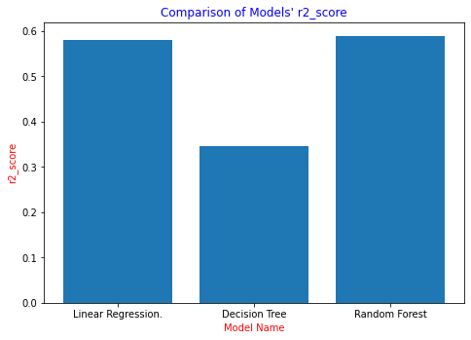
Model Evaluation
Random Forest is the best algorithm in those three to describe this data set

Slide 13
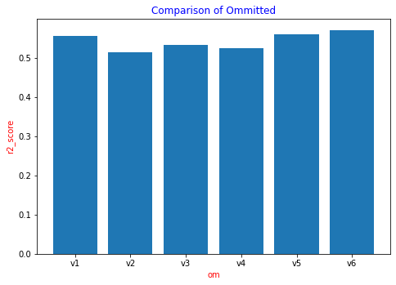
V1:Omitted “sqft_above”
V2:Omitted “grade”
V3:Omitted “view”
V4:Omitted “sqft_living”
V5:Omitted “bathrooms”
V6:Omitted “bedrooms”

Slide 14
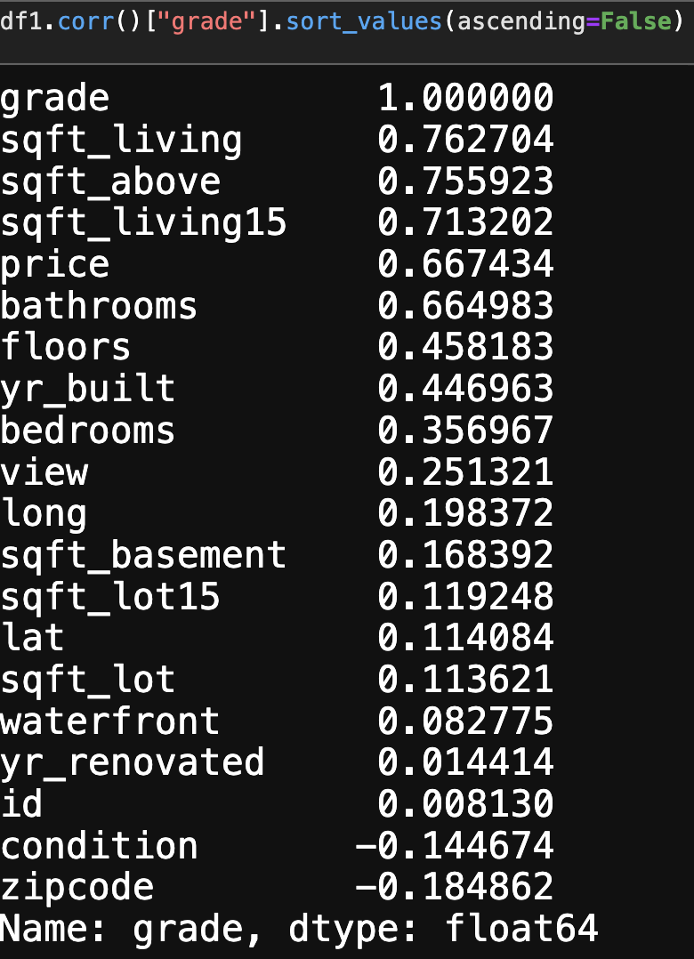
Which model is best to predict grade label?

Slide 15
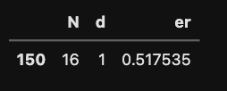
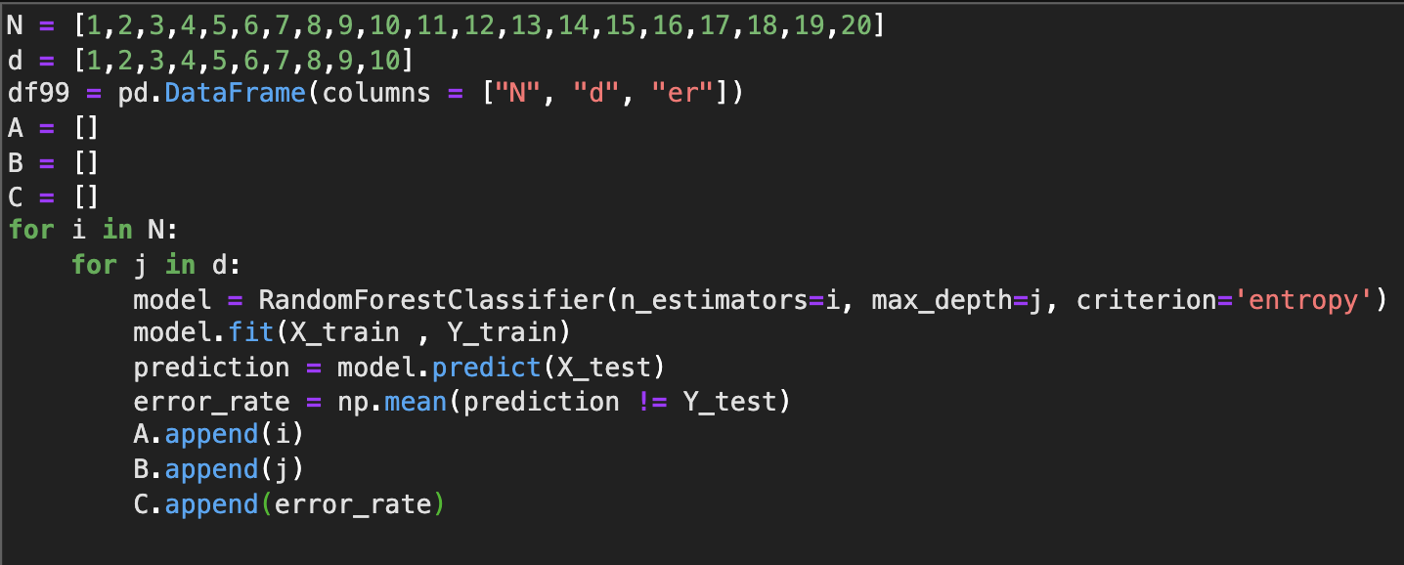
Accuracy (RF Classifier)
Use for loop I find a best N and d value to set.

Slide 16
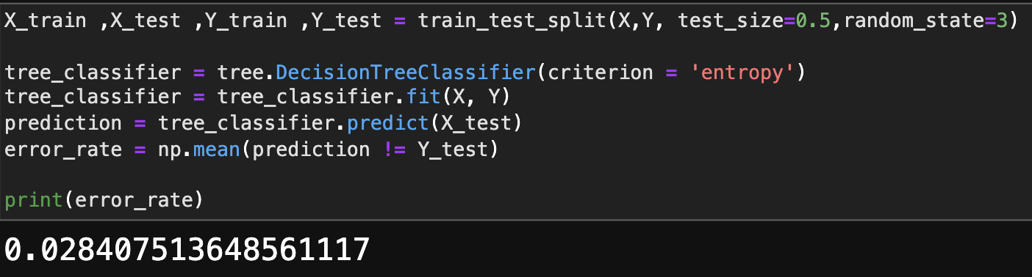
Accuracy (DT Classifier)

Slide 17
Conclusion
Which model is better for this data set?
Which feature is more important on this data set?
Decision tree classifier algorithm is a good algorithm to predict grade label

